Slide 1


DAYANANDA SAGAR UNIVERSITY
SCHOOL OF ENGINEERING
Department of Computer Science and Engineering
Minor project Review
INTELLIGENT ACCIDENT DETECTION AND ALERTING SYSTEM USING MACHINE LEARNING
Under the Supervision
Dr. Shreekant Salotagi
Assistant Professor
1
Presented By:
Arpita (ENG23CS0024)
Bhuvana A M (ENG23CS0037)
Darshini R (ENG23CS0053)
Notes:
Title of the project
CSE Dept., SET-Jain University
1

Slide 2
Overview
Abstract
Problem Statement
Objectives
Introduction
Literature Survey(State of the Art-work)
Social/Environmental Impact (If applicable)
Proposed Methodology
Design & Implementation
Demo (Very Important)
Results & Discussion
Conclusion & Future Scope
References
*
Dept of CSE., SOE-Dayananda Sagar University
2 of 12

Slide 3
Abstract
Road accidents are a major cause of injuries and fatalities, often due to delayed detection and response. This project presents an automated accident detection and alert system using deep learning and machine learning techniques. The system analyzes real-time video input from traffic surveillance cameras and classifies scenes into accident or non-accident using trained models. Once an accident is detected, the system retrieves the location, converts it into a readable address, and sends an instant alert via WhatsApp with coordinates and navigation link. This approach reduces response time and improves emergency assistance. The system demonstrates an effective integration of computer vision and communication technologies for enhancing road safety.
*
Dept of CSE., SOE-Dayananda Sagar University
3 of 12

Slide 4
Problem Statement
Road accidents are increasing rapidly, delay in detecting accidents and informing emergency services often results in loss of lives. Traditional systems depend on manual reporting, which may take time and may not provide exact location details. Therefore, there is a need for an automated system that can detect accidents in real-time and immediately send alerts with location information to nearest hospitals for faster medical assistance.
*
Dept of CSE., SOE-Dayananda Sagar University
4 of 12

Slide 5
Objectives
To develop a deep learning-based system for automatic accident detection using surveillance camera input.
To accurately classify accident and non-accident scenarios using trained machine learning models.
To reduce response time by detecting accidents in real time without human intervention.
To identify the exact location of the accident using predefined camera coordinates.
To send instant alerts with location details to emergency services through communication systems.
To improve road safety by enabling faster emergency response and assistance.
*
Dept of CSE., SOE-Dayananda Sagar University
5 of 12

Slide 6
Expected Outcomes
•Accurate detection of road accidents using deep learning models.
•Real-time identification of accident scenarios from surveillance camera input.
•Automatic generation of alerts without human intervention.
•Precise location details (coordinates and address) of the accident site.
•Instant notification to nearest hospital with navigation link.
•Reduced response time for medical and rescue assistance.
• Improvement in road safety through faster emergency response

Slide 7
Introduction
This project aims to develop an automated accident detection system using deep learning techniques that analyze real-time video input from traffic surveillance cameras to identify accident scenarios accurately. The scope of the project includes real-time monitoring, detection of accidents, and generation of instant alerts with location details to emergency services. It is assumed that the system operates with proper camera input, trained models, and internet connectivity to ensure accurate detection and timely communication.
*
Dept of CSE., SOE-Dayananda Sagar University
7 of 12

Slide 8
State of the Art-work
Author’s Name/ Paper Title | Conference/Journal Name and year | Technology/ Design | Results shared by author | What you infer
G.Siri,G.Priyanka,B.Divya,G.Sameera and M.Pallavi “Accident Detection and Alert System” Sinchana R.D, Sindhu K.S, Sudhakara H.M “Accident Detection and Alert System for Enhanced Safety and Response” Priyadarshini C. Patil, Padmanabhan Ghanate, Rishikesh Patil “Road Accident Detection and Alert Notification System using Machine Learning” | IRJETS vol.04,Issue06,2022. Vol.13, Issue11, 2024 IJSDR, Vol.10, Issue12, 2025 | IoT sensors, GPS, GSM, Microcontroller based alert system Embedded system with sensors, communication module Machine Learning classification model with alert system | Detects vehicle accident and sends emergency alerts with location Improved road safety with faster alert transmission Detects accident images/videos and sends notifications | Useful for reducing delay in emergency response using sensor networks Real-time automated response increases survival chances ML improves detection accuracy over sensor-only systems
*
Dept of CSE., SOE-Dayananda Sagar University
8 of 12

Slide 9
.
Author’s Name/ Paper Title | Conference/Journal Name and year | Technology/ Design | Results shared by author | What you infer
Devisha Arunadevi Tiwari, Emmadi Bhanu Sai, Bandapu Sai Chandu “Machine Learning based Accident Detection and Alert System” Gopal Sunil Rathod, Rani Chandrabhan Tipale, Dr. Kapil Jajulwar “Intelligent Accident Detection and Alerting System based on Machine Learning over the IoT Network” | JEITR, May 2024 IEEE INCOFT, 2022 | Machine Learning algorithm with automated messaging Machine Learning + IoT Network | Accurate accident prediction with quick alert mechanism Smart accident monitoring and real-time alerts | AI-based detection is effective for smart traffic monitoring Combining IoT with ML increases efficiency and scalability
*
Dept of CSE., SOE-Dayananda Sagar University
9 of 12

Slide 10
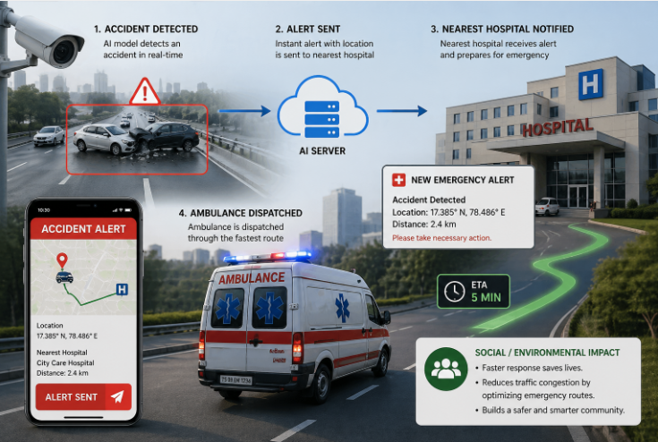
Social/Environmental Impact
*
Dept of CSE., SOE-Dayananda Sagar University
10 of 12

Slide 11
Proposed Methodology
Collected dataset consisting of accident and non-accident images from multiple sources.
Performed basic preprocessing such as resizing and normalization of images.
Trained deep learning models to classify accident and non-accident scenarios.
Selected the best-performing model based on accuracy.
Implemented real-time detection using camera input and trained model.
Generated automatic alerts with location details upon accident detection.
*
11 of 12
Dept of CSE., SOE-Dayananda Sagar University

Slide 12
Design & Implementation
System Architecture
The system captures image input from a camera.
These images are processed using a trained deep learning model for prediction.
Once an accident is detected, the system identifies the location and generates an alert.
Data Handling (instead of Database Design)
• The dataset consists of accident and non-accident images used for training the model. • The data is preprocessed by resizing and normalizing images before training. • Camera locations are stored as predefined coordinate values for alert generation.
*
Dept of CSE., SOE-Dayananda Sagar University
12 of 12

Slide 13
Platforms / Systems / Services
• The system is developed using Python along with TensorFlow/Keras and OpenCV. • Twilio API is used for sending WhatsApp alerts. • Geopy and Geocoder are used for location processing.
Module Relationships
• The detection module identifies accident scenarios from input data. • The location module retrieves coordinates and converts them into an address. • The alert module sends notifications to emergency services.

Slide 14
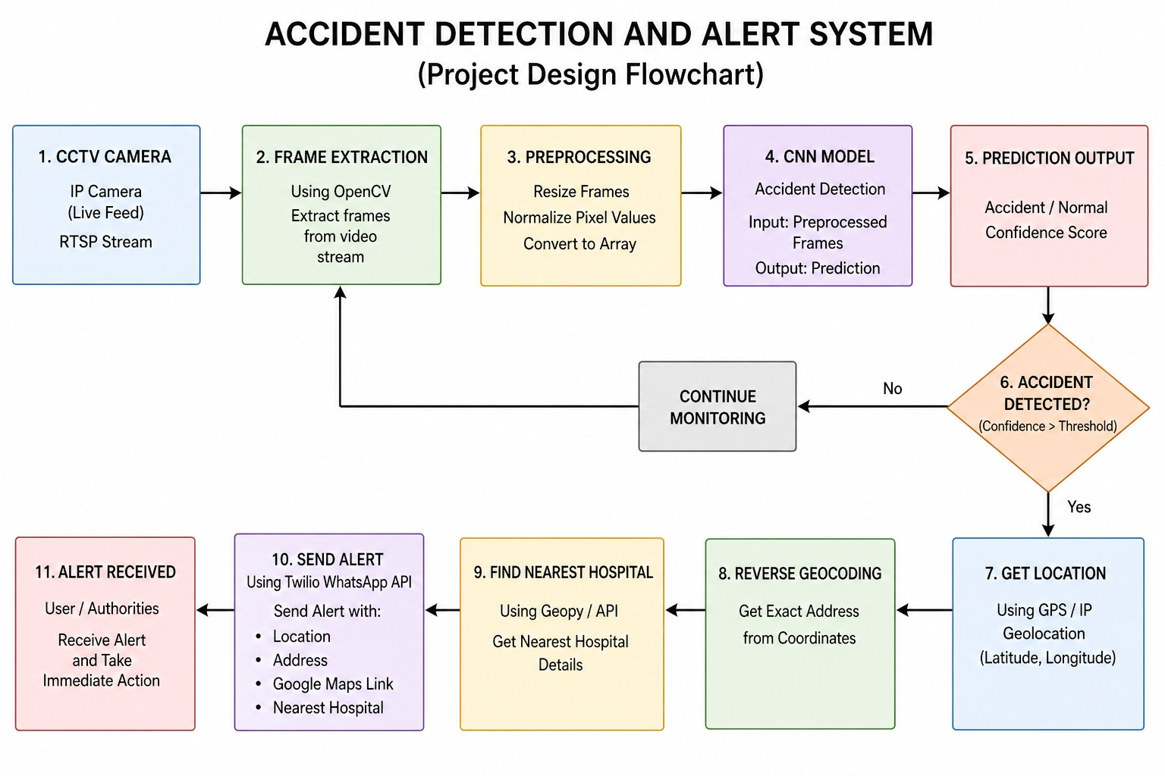
Design
design flow-chart of accident detection and alert system

Slide 15
.
The above image illustrates the complete workflow of an accident detection and alert system. Initially, a traffic surveillance camera captures a road accident, which is analyzed by a deep learning model to detect the incident in real time. Once an accident is identified, the system immediately sends an alert with precise location details to a central server, which then forwards the information to the nearest hospital. The hospital receives the alert and prepares for emergency response, while an ambulance is dispatched through the fastest route using navigation guidance. The mobile alert interface displays key details such as coordinates, distance and route to the hospital. This system ensures faster emergency response, reduces traffic delays through optimized routing, and ultimately contributes to saving lives and improving road safety.

Slide 16
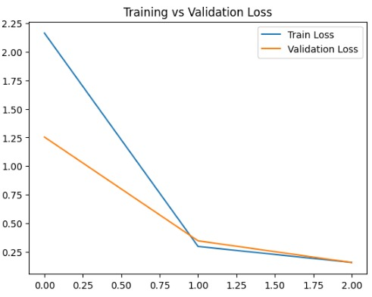
Results
Training vs Validation Loss Graph
The graph shows that both training and validation loss decreases steadily over epochs, which indicates model is learning efficiently with minimal overfitting.

Slide 17
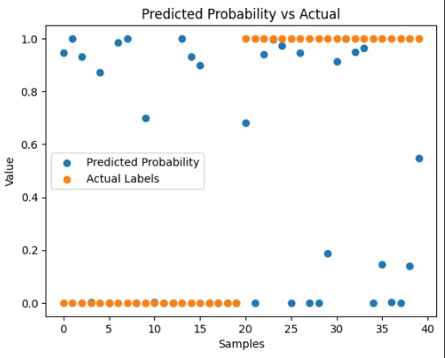
.
Predicted Probability vs Actual Value
Most of the predictions matches actual labels, which indicates model performs accurately with less mismatches.

Slide 18
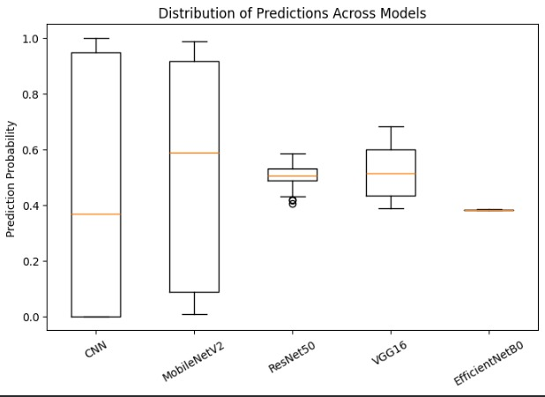
.
Distribution of Prediction Across Models
Model like ResNet50 and VCG16 shows more consistent predictions with less variation, while CNN and MobileNetV2 shows wider spread which indicates higher uncertainity in accident classification.

Slide 19
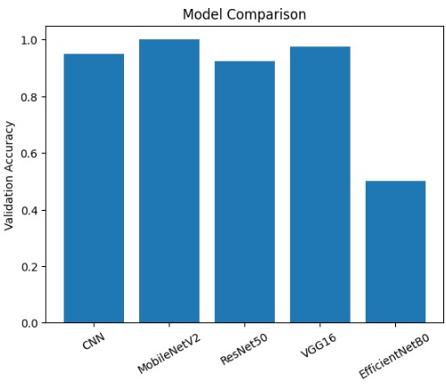
.
Model Accuracy Comparison graph
The graph illustrates the performance comparison of various model for accident detection based on validation accuracy.

Slide 20
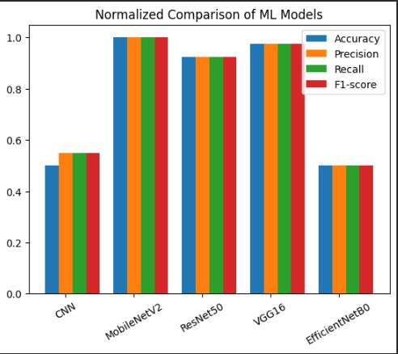
Normalized Comparison of ML Models
The graph represents a normalized performance comparison based on accuracy, precision, recall and F1-score. Among all the models MobileNetV2 achieved the highest performance.

Slide 21
Discussion
Performance Analysis
The performance analysis of the proposed Accident Detection and Alert System was carried out using multiple evaluation metrics such as accuracy, precision, recall and F1-score. Five deep learning models were tested, namely CNN, VGG16, MobileNetV2, ResNet50 and EfficientNetB0. Among them, VGG16 achieved the highest validation accuracy, while CNN provided a good balance between accuracy and computational efficiency. Since the project requires real-time accident detection, CNN was selected for final implementation due to its faster processing speed and lower resource consumption. Training and validation loss graphs also showed proper convergence, indicating effective learning and reliable performance of the model.

Slide 22
Conclusion
This project successfully developed an Intelligent Accident Detection and Alert System using a CNN-based deep learning model to identify accidents from real-time images. The system captures image through a camera, processes each frame using OpenCV and classifies it as accident or non-accident. When an accident is detected, the system automatically sends a WhatsApp alert containing the accident location, address and map link to the concerned authority or nearest hospital using Twilio API. Multiple models were evaluated and CNN was selected for deployment due to its balance of accuracy, speed and efficiency.

Slide 23
Future Scope
In future enhancements, the accident detection and alert system can be improved by integrating real-time navigation and traffic analysis to automatically suggest the nearest hospital with the least traffic congestion. By using map services such as Google Maps APIs, the system can identify the fastest route instead of only the shortest distance, helping emergency services reach the accident spot quickly. This enhancement can significantly reduce response time, improve patient safety and make the system more practical for real-world smart transportation applications.

Slide 24
References
[1]G.Siri,G.Priyanka,B.Divya,G.Sameera,M.Pallavi, “Accident Detection and Alert System” IRJETS vol.04,Issue06,June-2022.
[2]Sinchana.RD,Sindhu.KS,Sudhakara.HM, “Accident Detection and Alert System for enhanced Safety and Response”, vol.13,Issue11,2024.
[3]Priyadarshini.C.patil,Padmanabhan Ghanate, Rishikesh patil, “Road Accident Detection and Alert Notification System using Machine Learning ”, IJSDR vol.10,Issue12, 2025.
[4]Devisha Arunadevi Tiwari,Emmadi Bhanu Sai,Bandapu Sai Chandu,”Machine Learning based Accident detection and Alert System” JEITR, May 2024.
[5]Gopal Sunil Rathod,Rani Chandrabhan Tipale,Dr. Kapil Jajulwar,”Intelligent Accident Detection and Alerting System based on Machine Learning over the IoT Network”2022 International Conference on Futuristic Technologies (INCOFT) Karnataka, India. Nov 25-27, IEEE 2022.
*
24 of 12
Dept of CSE., SOE-Dayananda Sagar University

Slide 25
References
[6]Swapnali.R.Pawar,Rushikesh Bamne,Shreyash Patil,Sushant Chipate,Tanmay Vasagadekar,”Detection and Alert generation of road accident using Deep Learning”International Conference on Healthcare Innovations,Software and Engineering Technologies(HISET), IEEE 2024.
[7]VICTOR A. ADEWOPO,NELLY ELSAYED,”Smart City Transportation: Deep Learning Ensemble Approach for Traffic Accident Detection “,IEEE 2024.
[8]Pritam Banik Roy,Draksha,Ankika Dey,Rajendrani Mukherjee,Suparna Biswas,Suvamoy Changder,”Vehicle Tracking and Accident Prevention using Smart Technologies”,21st India Council International Conference (INDICON),IEEE 2024.
[9]Ravi K Kodali,Shubhi Sahu,”MQTT Based Vehicle Accident Detection and Alert System”,IEEE 2017.

Slide 26
References
[10]Aman Kumar Agrawal, Kadamb Agarwal, Jitendra Choudhary, Aradhita Bhattacharya, Srihitha Tangudu, Nishkarsh Makhija,Rajitha B,”Automatic Traffic Accident Detection System Using ResNet and SVM”,Fifth International Conference on Research in Computational Intelligence and Communication Networks (ICRCICN),IEEE 2020.
[11]Arnav Chaudhari, Harsh Agrawal, Smiti Poddar, Kiran Talele, Manisha Bansode "Smart Accident Detection And Alert System" IEEE India Council International Subsection Conference(INDISCON) 2021.

Slide 27
THANK YOU
*
Dept of CSE., SOE-Dayananda Sagar University
(#) of 12

